Slide 1
Rusape town council clients charter

Slide 2
Preamble
Rusape Town Council is a local authority which was established in 1990. It has ten wards. The name Rusape is derived from a shona word “Rusapwe” which means never dries, with reference to the ever flowing waters of Rusape River, adjacent to the town. Rusape is a Town that is striving to reach municipal status. It is situated along the Harare – Mutare road and railway line. It is 180 km to Harare, 95km from Mutare, 102km from Nyanga and approximately 220 km from Chivhu. Rusape has a population of 31080 as per 2012 census and a land area of 1050 ha which lies in region 3. It is in the North-Eastern part of Manicaland Province in Makoni District.

Slide 3
Vision, Mission Statement and Core Values
Vision
A modern City by 2030.
Mission Statement
Core Values
To provide municipal service delivery.
Proactiveness,
Accountability,
Responsiveness,
Integrity,
Transparency.

Slide 4
Mandate To provide quality service delivery to all Rusape residents.
Constitution of Zimbabwe amendment (No 20) of 2013.
Urban Council Act (Chap 29:15).
Public Finance Management Act.
Regional, Town and Country Planning Act (Chap 29:12).
EMA Act (Chap 20:26).
Labour Act.
Public Health Act.
Liquor Act.
RDC Act (Chap 29:13).
Rusape Town Council By-laws.

Slide 5
Achievements and major highlights for 2024…
Updating of website
FORMULATED HOUSING HEALTH AND COMMUNITY SERVICES STARNDARD OPERATING PROCEDURES, STANDS ALLOCATION PROCEDURE MANUAL, CESSION PROCEDURE MANUAL AND THE STANDS REPOSSESSION PROCEDURE MANUAL.
Review of master plan in progress (100%)
UPDATING OF VALUATION ROLL IN PROGRESS (100%)
FORMULATION OF WASH MASTER PLAN IN PROGRESS
INTEGRITY COMMITTEE IN PLACE
ALL SENIOR POSTS FILLED
CONTRACTS FOR SENIOR MANAGEMENT SIGNED
5 POLICIES REVIEWED AND 6 FORMULATED

Slide 6
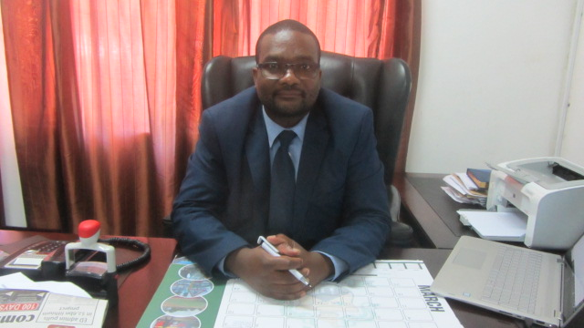
Departments in the Organization and their Core Functions.
Town Secretary
Central Administration
Engineering
Housing
Finance
ACTING TOWN SECRETARY
TOWN SECRETARY
MR. S. GABAZA

Slide 7
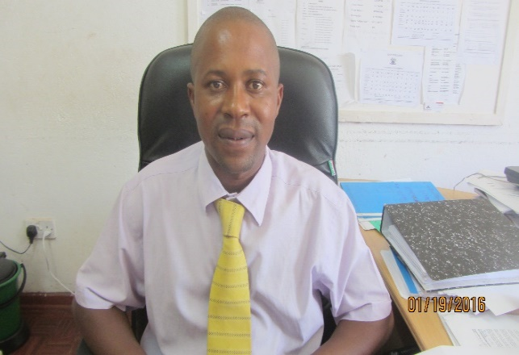
Central Administration (Human Resources)
Vision,
Mission &
Core functions.
To become the nerve centre for all council operations.
To provide good corporate governance, human resources and administration services.
Secretarial services, risk control, Human capital management and development, procurement , gender mainstreaming, good corporate governance.
HUMAN CAPITAL AND ADMIN OFFICER
MR. T. NERWANDE

Slide 8
Central Administration (ICT)
Vision,
Mission &
Core functions.
To become a reliable and effective Town’s ICT infrastructure and supporting the Council services through advanced technology
To ensure that all technological systems and services are operational, maintained and upgraded as necessary to meet the needs of the Town and residents.
Mantaining hardwareand software, monitoring system performance, data storage and backups, Cybersecurity Application management, IT management and Administration
ICT MANAGER: MS NYASHA MATARE

Slide 9
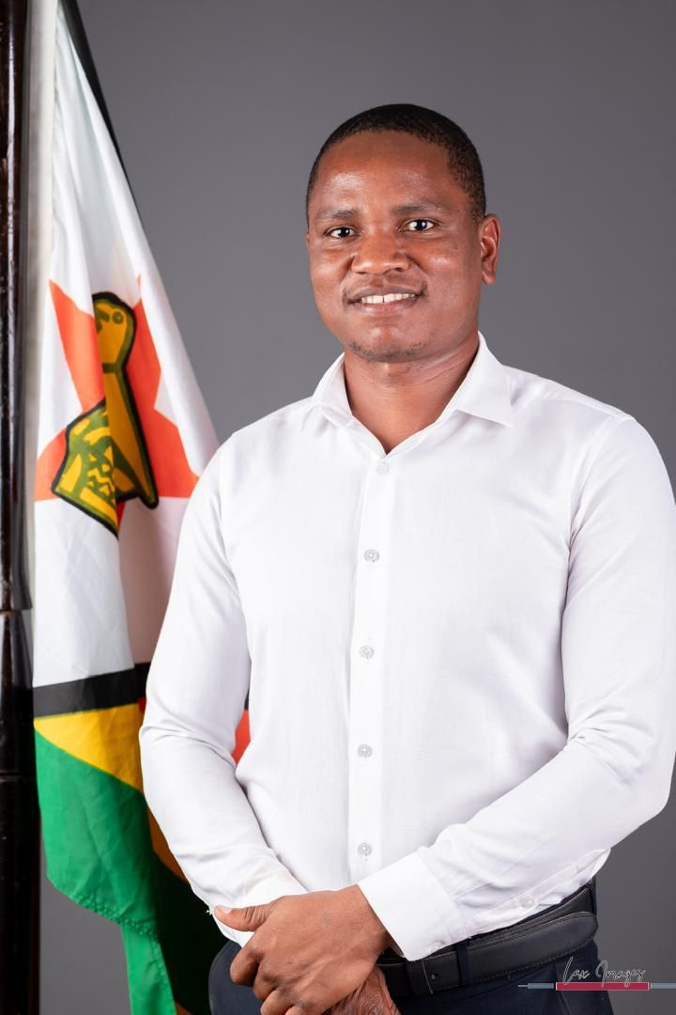
Central Administration (town planning)
Vision,
Mission &
Core functions.
To provide well planned and well governed human settlements
To create habitable, sustainable and thriving communities.
-Provision of Town Planning Services
-Provision of Development/Land Management Services
-Provision of Building Inspectorate Services
-Provision of Land Survey Services
-Provision of GIS services
-Provision of Valuation services
TOWN PLANNER:
MR BLESSING KWAMBANA

Slide 10
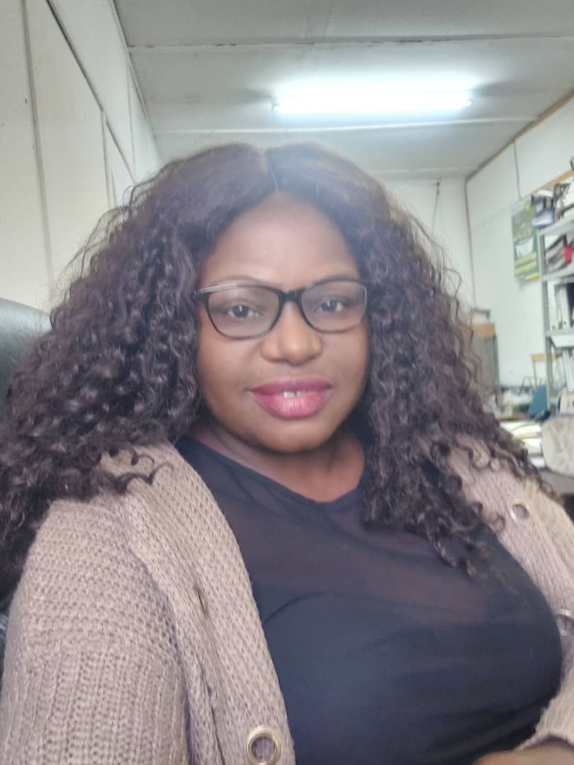
Central Administration (Internal Audit)
Vision,
Mission &
Core functions.
To become the most valued resource centre for unique audit services, corporate governance and risk control activities
Internal Audit function exists to provide independent and objective assurance to improve the effectiveness of risk management, and governance processes by upholding the spirit of transparency, fairness, and in accordance with the highest professional and ethical standards.
Transparency
Accountability
Honest
Integrity
Objectivity
Fairness
Proactive
Acting Internal Auditor
Ms G Gudyanga

Slide 11
Central Administration (procurement)
Vision,
Mission &
Core functions.
An objective of Public Procurement and Disposal Assets Act Chapter 22:23
To ensure that procurement is effected in a manner that is transparent, fair, honest, cost effective competitive and to promote competition, fair and equitable treatment amongst bidders
The function exists to provide contracts that that represent good value for money, to promote integrity, fairness and public confidence in procurement processes. To secure the implementation of any environmental , social, economic and other policy that is authorized or required by any law to be taken into account by a procuring entity in procurement proceedings.
PROCUREMENT MANAGER: MR SILVANUS SHIRI

Slide 12
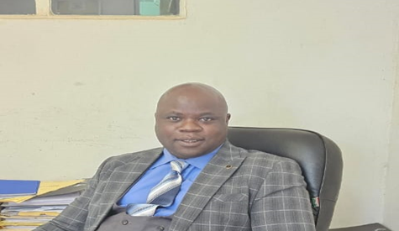
Finance Department
Vision,
Mission &
Core Functions.
To become a financially stable Finance Department.
To mobilise and allocate resources in a transparent, efficient, effective and equitable (gender sensitive) manner.
Revenue collection, safe custody of all security items of council, cost control, budgeting, preparation of financial statements, advising council on financial matters.
ACTING TOWN TREASURER
MR. G. NYAMANDE

Slide 13
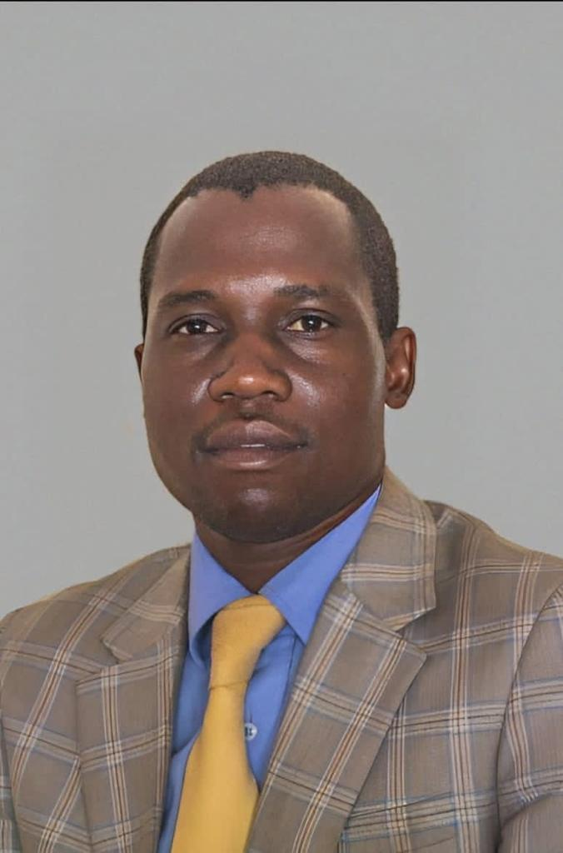
Housing Department DHH&CS : MR MORRIS TEKWA
Vision,
Mission &
Core Functions.
To become an excellent provider of quality and affordable accommodation and social services.
To provide quality housing and social services in an effective and efficient manner to the community of Rusape.
Provision of affordable stands for commercial, residential, industrial, institutional and recreational purpose etc., provision of community services i.e. cemeteries, recreational etc., provision of Health Services and Promotion of local economic development.

Slide 14
Engineering Department
Vision,
Mission &
Core Functions.
To become an excellent service provider.
To construct, maintain, rehabilitate and provide quality infrastructure and utility services.
Water provision, Sewer reticulation, roads construction and maintenance, public and street lighting, provision of town planning services, construction and maintenance of council infrastructure, plant and equipment.
TOWN ENGINEER
ENGINEER. C. CHINDENGA

Slide 15
External/Internal Clients and service commitments and standards
External
Ratepayers
Civic Societies
Internal
Government
Churches
NGOs/Development partners
Business community and SMEs
Other local authorities
Government
Councillors
Employees
Service commitments and standards
Complaints to be attended within 24hrs.
Preparation of final accounts for external audit within 120 days .
Performance appraisals quarterly.
Preparation of management account within 7 days from month end.
Enterprise risk assessment half yearly.
Provide portable water at all times.
Attend to burst water and sewer pipes within 30 minutes.
Effect new water and sewer connection within 2 days.
Updating housing registers daily.
Collection of refuse once per week in residential areas and daily in commercial and industrial.

Slide 16
Obligations and rights
Service Provider Obligation
To provide good service delivery to all our residents and ratepayers.
Rights
To collect revenue from all our ratepayers and residents.
To sue defaulting creditors.
Clients Obligation and Right
To pay their bills.
The right to receive good service.
Change for services.
Review of Clients Charter
We review our clients charter twice a year/as and when need arise or necessary.
Feedback /How to contact the organisation
Telephone lines
Contact Addresses
All communications to be addressed to
E-mails
Ward meetings
website
The Town Secretary at: Stand No. 398 Manda Avenue, Rusape Box 17 ,Rusape

